Slide 1
Guide to Networking Essentials,
6th Edition
Chapter 3: Network Topologies and Technologies

Slide 2
Objectives
Describe the primary physical networking topologies in common use
Describe the primary logical networking topologies in common use
Describe the major LAN networking technologies
Copyright © 2012 Cengage Learning. All rights reserved.

Slide 3
Physical Topologies
Describe the lay of the land
A network topology describes how a network is physically laid out and how signals travel from one device to another
Since the physical layout of the devices and cables doesn’t describe how signals travel from one device to another, they are broken down into physical and logical topologies
Copyright © 2012 Cengage Learning. All rights reserved.

Slide 4
Physical Topologies
The arrangement of cabling and how cables connect one device to another in a network is considered the network’s physical topology
The path data travels between computers on a network is considered the network’s logical topology
All network designs today are based on these basic physical topologies: bus, star, ring, and point-to-point
Copyright © 2012 Cengage Learning. All rights reserved.

Slide 5
Physical Bus Topology
Physical bus topology is the simplest and once was the most common method for connecting computers
  Defined as a continuous length of cable connecting one computer to another in daisy-chain fashion
There’s a limit of 30 computers per cable segment
The maximum total length of cabling is 185 meters
Both ends of the bus must be terminated
Any break in the bus brings down the entire network
Adding or removing a machine brings down the entire network temporarily
Technologies using this topology are limited to 10 Mbps half-duplex communication since they use coaxial cabling
Copyright © 2012 Cengage Learning. All rights reserved.

Slide 6
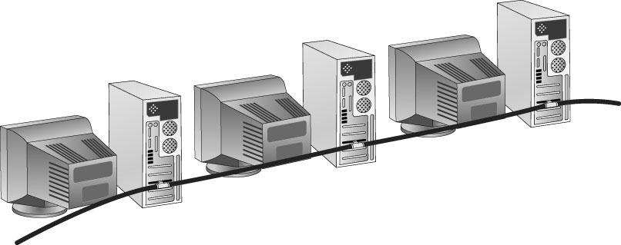
Physical Bus Topology
Due to the limitations, this topology is no longer a practical choice and technology has moved past this obsolete method of connecting computers
Copyright © 2012 Cengage Learning. All rights reserved.

Slide 7
How Data Travels in a Physical Bus
Electrical pulses (signals) travel the cable’s length in all directions
Signal continues until it weakens or is absorbed by a terminator
  A terminator is an electrical component called a resistor that absorbs the signal instead of allowing it to bounce back up the wire
Signal travel across the medium and from device to device is called signal propagation
If not terminated, the signal bounces or is reflected at end of medium
  Signal bounce is the term used when electricity bounces off the end of a cable and back in the other direction
Copyright © 2012 Cengage Learning. All rights reserved.

Slide 8
Physical Star Topology
Uses a central device (hub or switch) to connect computers
Advantages:
  Much faster technologies than a bus
  Centralized monitoring and management of network traffic is possible
  Easier network upgrades
Copyright © 2012 Cengage Learning. All rights reserved.

Slide 9
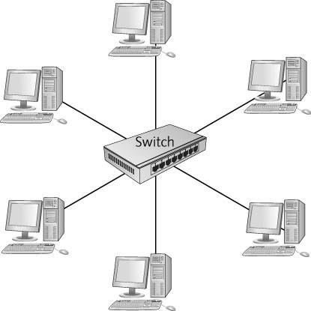
Physical Star Topology
Copyright © 2012 Cengage Learning. All rights reserved.

Slide 10
Physical Star Topology
Using a central device allows for monitoring and managing a network
  Today’s hubs and switches can include software that collects statistics about network traffic patterns and even alerts when excessive errors or unusually high traffic rates are occurring
As long as cabling and NICs support it, a star network can be easily updated by simply replacing the central device
When the number of workstations you need exceeds the number of ports on a central device, you simply add another central device
Copyright © 2012 Cengage Learning. All rights reserved.

Slide 11
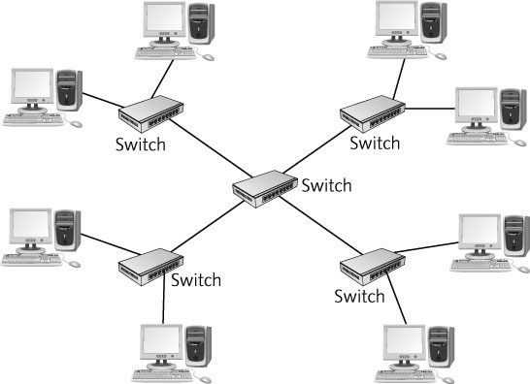
Extended Star
When several hubs or switches must be connected, usually one device is used as the central connecting point, forming an extended star topology
Copyright © 2012 Cengage Learning. All rights reserved.

Slide 12
Extended Star
Most widely used in networks containing more than just a few computers
A central device (usually a switch) sits in the middle and instead of attached computers, other switches or hubs are connected to the central switch’s ports
  Computers and peripherals are then attached to these switches or hubs forming additional stars
Sometimes referred to as a “hierarchical star”
Copyright © 2012 Cengage Learning. All rights reserved.

Slide 13
How Data Travels in a Physical Star
Depends on central device
Central device determines “logical” topology
  Logical topology is discussed later in the chapter
  For now: hub = logical bus; switch = logical switching; MAU = logical ring
Copyright © 2012 Cengage Learning. All rights reserved.

Slide 14
Physical Star Disadvantages
There are many advantages of a physical star
There is one disadvantage
  The central device represents a single point of failure
  If the hub or switch fails or someone kicks the power cord out of the outlet, the entire network goes down
  Having a spare on hand is a good idea
Copyright © 2012 Cengage Learning. All rights reserved.

Slide 15
Physical Ring Topology
A physical ring topology is like a bus
  Devices are daisy-chained one to another
  But instead of terminating each end, the cabling is brought around from the last device back to the first device to form a ring
Most widely used to connect LANs with a technology called Fiber Distributed Data Interface (FDDI)
FDDI was most often used as a network backbone, which is cabling used to communicate between LANs or between hubs and switches
Copyright © 2012 Cengage Learning. All rights reserved.

Slide 16
Physical Ring Topology
Data travels in one direction
If any station in the ring fails, data can no longer be passed along
FDDI uses dual ring
  Data travels in both directions
  One ring failure doesn’t break network
  Operates using fiber-optic cable at 100 Mbps
  Extended star topologies with Gigabit Ethernet have largely replaced FDDI
Copyright © 2012 Cengage Learning. All rights reserved.

Slide 17
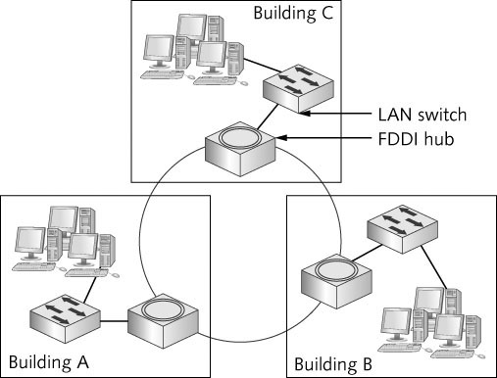
Physical Ring Topology
Copyright © 2012 Cengage Learning. All rights reserved.

Slide 18
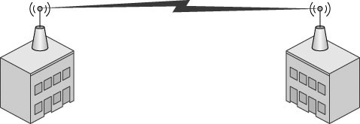
Point-to-Point Topology
Direct link between two devices
Mostly used in WANs
Wireless bridge
Used to connect two computers
Copyright © 2012 Cengage Learning. All rights reserved.

Slide 19
Mesh Topology
Connects each device to every other device in a network
  Multiple point-to-point connections for the purposes of redundancy and fault tolerance
Purpose of creating a mesh topology is to ensure that if one or more connections fail, there’s another path for reaching all devices on the network
Expensive due to multiple interfaces and cabling
Found in large WANs and internetworks
Copyright © 2012 Cengage Learning. All rights reserved.

Slide 20
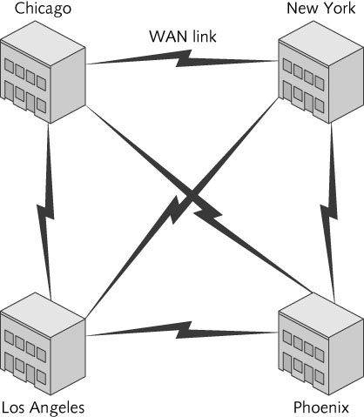
Mesh Topology
Copyright © 2012 Cengage Learning. All rights reserved.

Slide 21
Logical Topologies
Describes how data travels from computer to computer
Sometimes same as physical topology
  In a physical bus and physical ring, the logical topology mimics the physical arrangement of cables
  For physical star, electronics in central device determine logical topology
Copyright © 2012 Cengage Learning. All rights reserved.

Slide 22
Logical Topologies
Logical topology | Network technology | Physical topology | Description
Bus | Ethernet | Bus or star | A logical bus topology can be implemented as a physical bus (although this topology is now obsolete). When a logical bus is implemented as a physical star using wired Ethernet, the center of the star is an Ethernet hub. Whatever the physical topology is, data transmitted from a computer is received by all other computers.
 | Wireless LANs | Star | Wireless LANs use a physical star topology because they connect through a central access point. However, only one device can transmit at a time and all devices hear the transmission, so a wireless LAN can be considered a logical bus topology.
Ring | Token ring | Star | Token ring networks use a central device called a multistation access unit (MAU or MSAU). Its electronics form a logical ring, so data is passed from computer to computer in order, until it reaches the destination device.
 | FDDI | Ring | As discussed, FDDI devices are connected in a physical ring, and data passes from device to device until it reaches the destination.
Switched | Ethernet | Star | A switched logical topology using a physical star topology running Ethernet is by far the most common topology/technology combination now and likely will be well into the future. A switched topology creates dynamic connections or circuits between two devices whenever data is sent. This topology is sometimes considered a switched point-to-point topology because a circuit is established between two points as needed to transfer data (like turning on a switch), and then the circuit is broken when it’s no longer needed (like turning off a switch).
Copyright © 2012 Cengage Learning. All rights reserved.

Slide 23
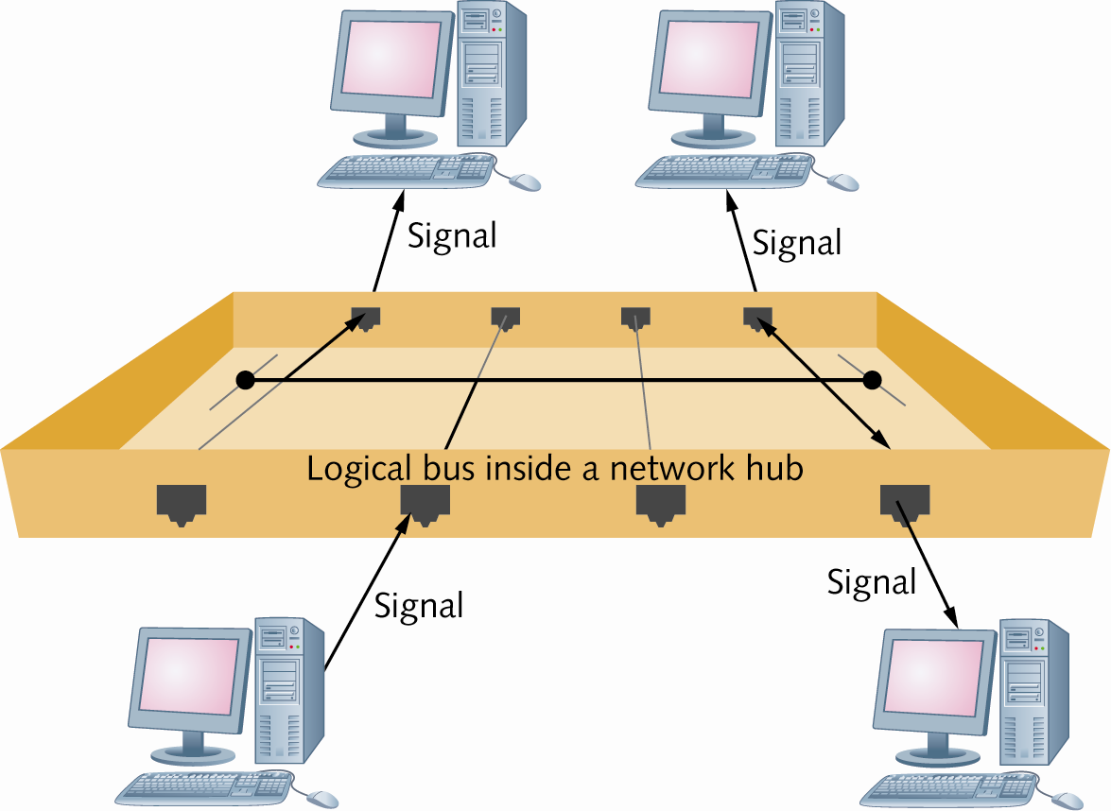
Logical Topologies
A logical bus implemented as a physical star
Copyright © 2012 Cengage Learning. All rights reserved.

Slide 24
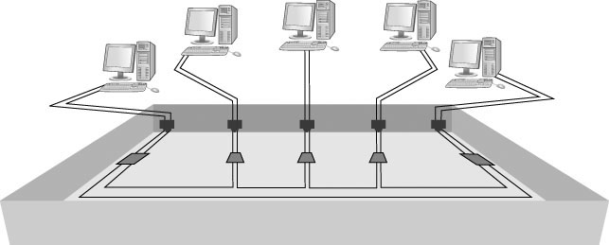
Logical Topologies
A logical ring using a physical star implements the ring inside
the central device’s electronics, which is a MAU in the token
ring technology
Copyright © 2012 Cengage Learning. All rights reserved.

Slide 25
Logical Topologies
In a switched topology, there is always an electrical connection between the computer and the switch but when no data is being transferred there is no logical connection or circuit between the devices
When the switch receives a frame, a logical circuit is made between the source and destination devices until the frame is transferred
Copyright © 2012 Cengage Learning. All rights reserved.

Slide 26
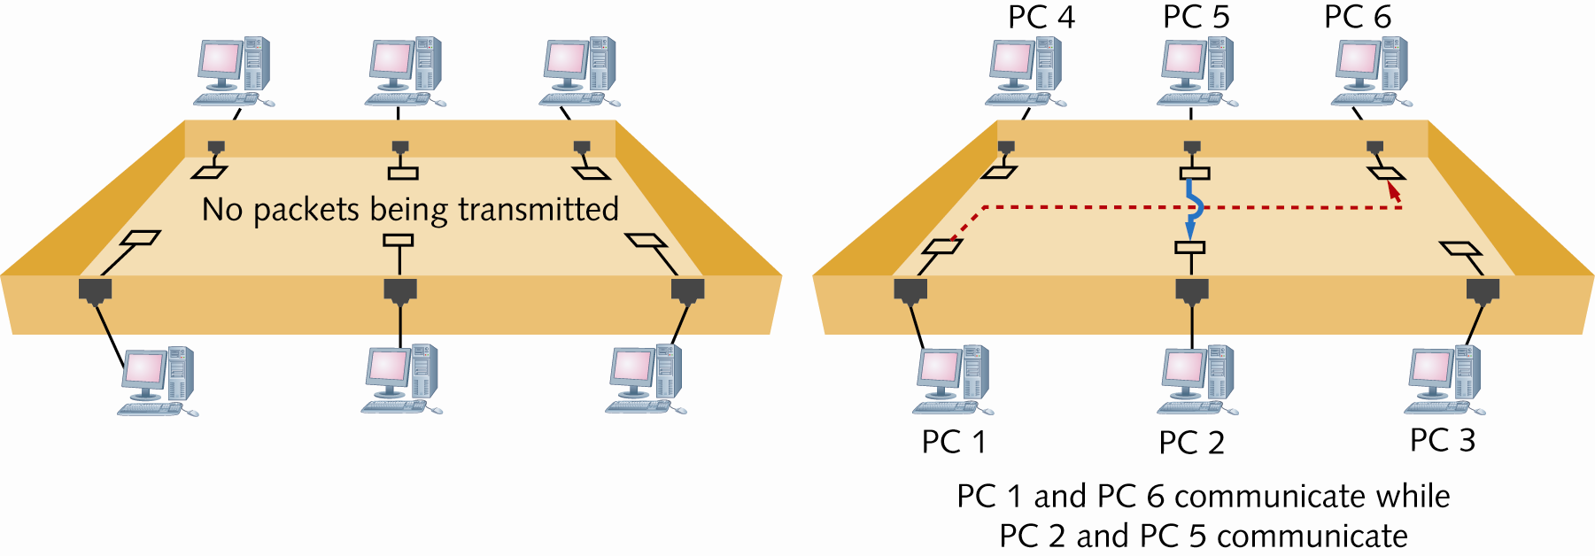
Logical Topologies
The logical functioning of a switch
Copyright © 2012 Cengage Learning. All rights reserved.

Slide 27
Network Technologies
The method a NIC uses to access the medium and send data frames
Other terms:
  Network interface/network access layer technologies
  Network architectures
  Data link layer technologies
Basically, it is whether your network uses Ethernet, 802.11 wireless, token ring, or some combination of these to move data from device to device in your network
Copyright © 2012 Cengage Learning. All rights reserved.

Slide 28
Network Technologies
LAN examples include
  Ethernet
  802.11 wireless
  Token Ring
WAN examples include
  Frame relay
  FDDI
  ATM
Network technology often defines frame format and media
Copyright © 2012 Cengage Learning. All rights reserved.

Slide 29
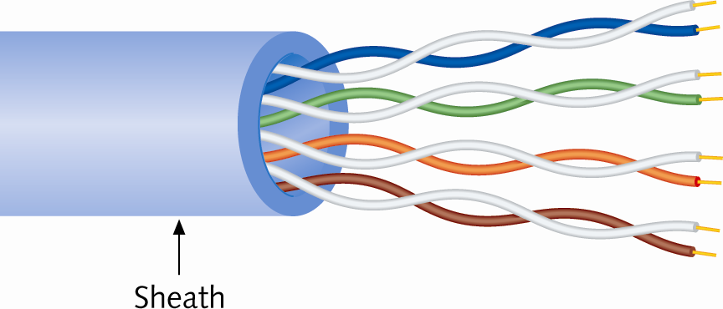
Network Technologies and Media
Unshielded Twisted pair (UTP)
  Most common media type in LANs
  Consists of 4 pairs of copper wires
  (each twisted together)
  Comes in numbered categories
Fiber-optic cabling uses thin strands of glass to carry pulses of light long distances and at high data rates
Coaxial cable is obsolete as a LAN medium but it is used as the network medium for Internet access via cable modem
Copyright © 2012 Cengage Learning. All rights reserved.

Slide 30
Baseband and Broadband Signaling
Network technologies can use media to transmit signals in two main ways
Baseband sends digital signals in which each bit of data is represented by a pulse of electricity or light
  Sent at a single fixed frequency and no other frames can be sent along with it
Broadband uses analog techniques to encode binary 1s and 0s across a continuous range of values
  Signals flow at a particular frequency and each frequency represents a channel of data
Copyright © 2012 Cengage Learning. All rights reserved.

Slide 31
Ethernet Networks
Most popular LAN technology
Easy to install and support with a low cost factor
Supports a broad range of speeds: 10 Mbps to 10 Gbps
Can operate in physical bus or physical star and logical bus or logical switching
Most NICs/hubs/switches can operate at multiple speeds: 10/100/1000
  Underlying technology is the same
Copyright © 2012 Cengage Learning. All rights reserved.

Slide 32
Ethernet Addressing
Every station has a physical (MAC) address
Each MAC address has 48 bits expressed as 12 hexadecimal digits
Incoming frames must match NIC’s address or broadcast address (FF-FF-FF-FF-FF-FF)
Once processed by NIC, incoming frames are sent to the network protocol for further processing
Copyright © 2012 Cengage Learning. All rights reserved.

Slide 33
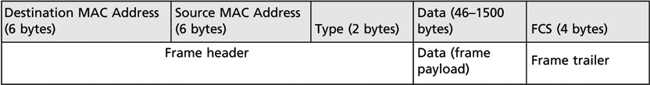
Ethernet Frames
Four different formats or frame types –depending on the network protocol used to send the frame
Ethernet II frame type used by TCP/IP
  TCP/IP has become the dominant network protocol in LANs so supporting multiple frame types has become unnecessary
Frames must be between 64 and 1518 bytes
  Destination MAC
  Source MAC
  Type
  Data
  FCS
Copyright © 2012 Cengage Learning. All rights reserved.

Slide 34
Ethernet Media Access
Media access method: Rules governing how and when the medium can be accessed for transmission
Ethernet uses Carrier Sense Multiple Access with Collision Detection (CSMA/CD)
  Carrier Sense: Listen before send – must hear silence
  Multiple Access: If two or more stations hear silence, multiple stations may transmit at the same time
  Collision Detection: If two or more stations transmit, a collision occurs and is detected by the NIC; all stations must retransmit
Simulation 7: Ethernet operation using CSMA/CD
Copyright © 2012 Cengage Learning. All rights reserved.

Slide 35
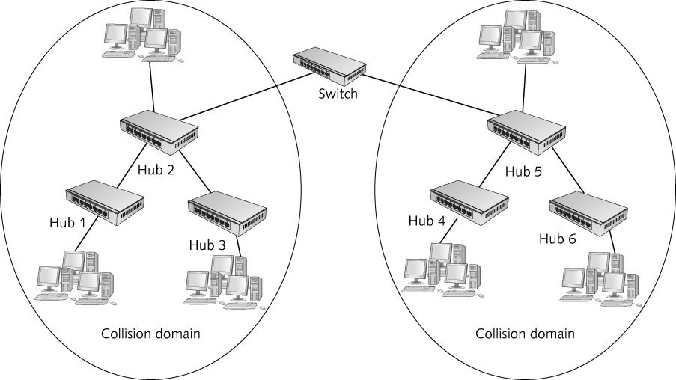
Collision and Collision Domains
All devices interconnected by one or more hubs hear all signals generated by all other devices
The extent to which signals in an Ethernet bus topology network are propagated is called a collision domain
All devices in a collision domain are subject to the possibility that whenever a device sends a frame, a collision might occur
Copyright © 2012 Cengage Learning. All rights reserved.

Slide 36
Ethernet Error Handling
Ethernet is a best-effort delivery system
  Like the post office; you hope it gets there but there is no acknowledgment either way
  Network protocols and applications must ensure delivery
  Only collisions are automatically retransmitted
Ethernet detects damaged frames
  The error-checking code in a frame’s trailer is called a Cyclic Redundancy Check (CRC)
  Uses CRC to determine that data is unchanged
  If a frame is detected as damaged, it is discarded with no notification
Copyright © 2012 Cengage Learning. All rights reserved.

Slide 37
Half-Duplex Versus Full-Duplex Communication
Half-duplex works like a two-way radio; you can talk and listen, but not both at the same time
  Ethernet on hubs works only in half-duplex
Full-duplex means NIC/switch can transmit/receive simultaneously
  Like a telephone
  CSMA/CD is turned off
  Switches can operate in full-duplex
Copyright © 2012 Cengage Learning. All rights reserved.

Slide 38
Ethernet Standards
Ethernet standards expressed as:
  XBaseY: 10Base2, 10BaseT, 100BaseT, 100BaseFX
  X: designates the speed of transmission
  Y: specifies the type of media (T = twisted-pair, FX = fiber optic)
10BaseT, 100BaseT use two pairs of wires
1000BaseT (Gig Ethernet) uses all four wire pairs
10GBaseT runs on Category 6A and in full-duplex only
40 and 100 Gb standard (802.3ba) recently ratified – uses fiber or 7 meter copper cable
Copyright © 2012 Cengage Learning. All rights reserved.

Slide 39
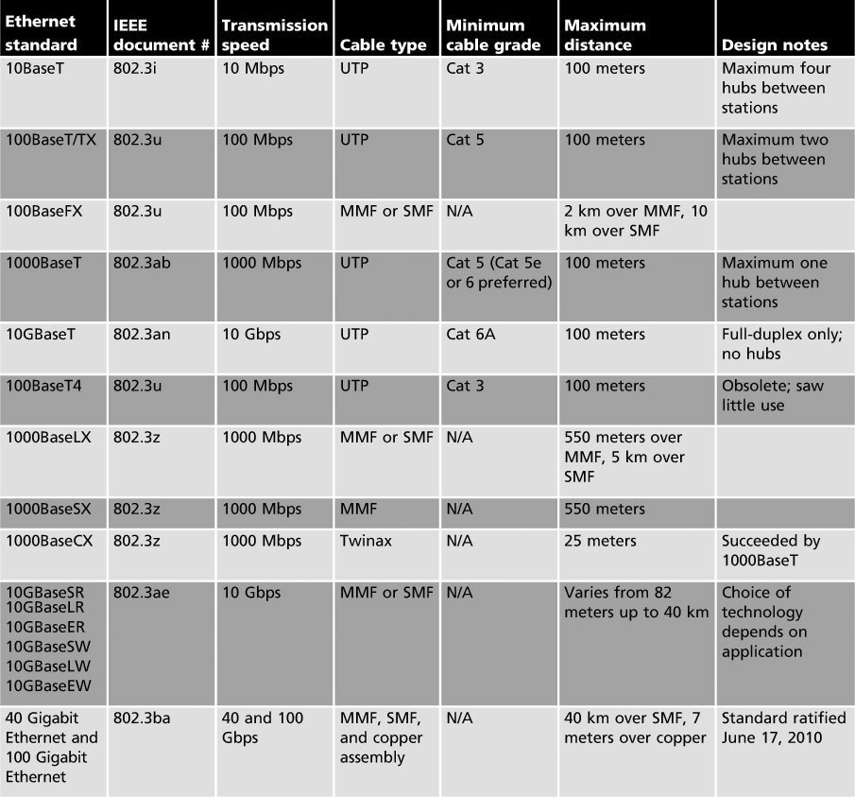
Ethernet Standards
Copyright © 2012 Cengage Learning. All rights reserved.

Slide 40
802.11 Wi-Fi
The 802.11 wireless networking standard is also referred to as Wireless Fidelity (Wi-Fi)
802.11 b/g/n run at 2.4 GHz radio frequency and are backward compatible
802.11 a runs at 5 GHz but not as prevalent
802.11 is an extension to Ethernet
Wi-Fi can operate in one of two modes
  Infrastructure — use central access point (AP)
  Ad hoc — no central device; data travels from device to device like a bus
Copyright © 2012 Cengage Learning. All rights reserved.

Slide 41
Wi-Fi Communication Channels
Wi-Fi operate at one of two radio frequencies:
2.4 GHz and 5.0 GHz (although this frequency is not fixed)
2.4 GHz is actually 2.412 thru 2.484 divided into 14 5 MHz channels
  Work like a TV channel – you must tune to the correct channel to connect
  Needs 25 MHz to operate spanning 5 channels
  Choose channels five apart from other known APs
5.0 GHz is actually 4.915 thru 5.825 GHz divided into 42 channels of 10, 20, or 40 MHz each
Copyright © 2012 Cengage Learning. All rights reserved.

Slide 42
Wi-Fi Security
Signals from a Wi-Fi network can travel several hundred feet – Wi-Fi devices outside your home or business can connect to an unsecured network
Wi-Fi network should be protected by an encryption protocol that makes data difficult to interpret
Encryption
  Wi-Fi Protected Access (WPA), WPA2, wired equivalent privacy (WEP)
Copyright © 2012 Cengage Learning. All rights reserved.

Slide 43
Wi-Fi Access Method and Operation
Wi-Fi Access Method
  Sending station can’t hear if another station begins transmitting so they cannot use the CSMA/CD access method that Ethernet uses
  Wi-Fi devices use carrier sense multiple access with collision avoidance (CSMA/CA)
  Uses request-to-send/clear-to-send (RTS/CTS) packets and acknowledgments
  With this extra “chatter”, actual throughput is essentially cut in half
Simulation 8: Basic wireless LAN operation
Copyright © 2012 Cengage Learning. All rights reserved.

Slide 44
Token Ring
Based on the IEEE 802.5 standard
Star physical topology, ring logical topology
A token is passed along the network
  Only the station with the token can transmit
  Frames are acknowledged and token is released
  No collisions
Originally operated at 4 Mbps and then increased to 16 Mbps and later 100 Mbps
Uses cat 4 and higher UTP
Obsolete
Copyright © 2012 Cengage Learning. All rights reserved.

Slide 45
Fiber Distributed Data Interface Technology
Physical and logical ring topology
Uses a token-passing access method and dual rings for redundancy
Transmits at 100 Mbps and can include up to 500 nodes over a distance of 60 miles
Uses fiber-optic cable only
Obsolete on new networks
Copyright © 2012 Cengage Learning. All rights reserved.

Slide 46
Internet Access Technologies
Cable modem networking is a broadband technology used to deliver Internet access to homes and businesses
  Two “TV” channels used to transmit and receive channels
Data Over Cable Service Interface Specification (DOCSIS) is the governing standard – provides security
Shared media from distribution hub to home
Asymmetrical communication
  Downstream rates are higher than upstream rates
DOCSIS 3.0 = Wideband Internet, up to 60 Mbps
Copyright © 2012 Cengage Learning. All rights reserved.

Slide 47
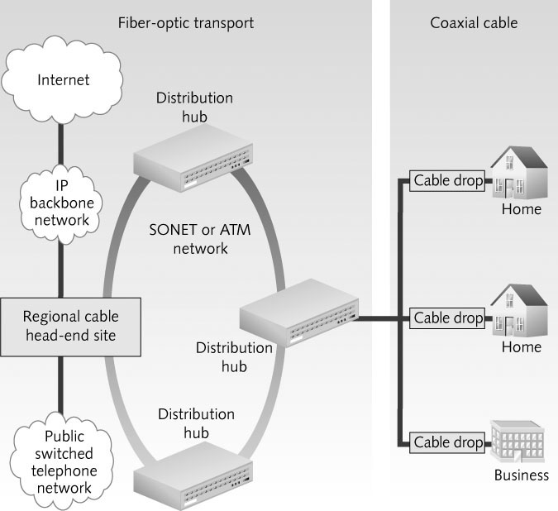
Internet Access Technologies
A Typical Cable Modem Network
Copyright © 2012 Cengage Learning. All rights reserved.

Slide 48
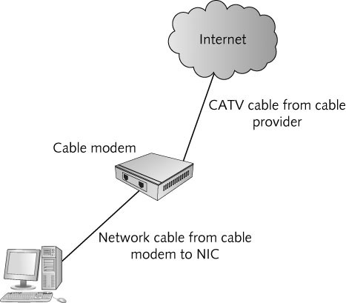
Cable Modem Operation
The cable modem has a tuner that “tunes in” the frequencies for upstream and downstream channels for Internet access
Cable modem has a MAC address
  Cable company uses it to allow access to their network
  The cable modem compares the destination address of incoming data to determine whether the modem should process arriving data
Copyright © 2012 Cengage Learning. All rights reserved.

Slide 49
Digital Subscriber Line
DSL/ADSL (Asymmetrical Digital Subscriber Line)
  Uses existing phone lines to carry voice and data simultaneously
  Asymmetric – download and upload speeds differ substantially
  256 K to 8 Mbps download
  16 K to 640 Kbps upload
  Must be within 23,000 feet of vendor equipment
    DSL’s main disadvantage
Symmetric DSL (SDSL)
  Upload and download speeds are the same
Copyright © 2012 Cengage Learning. All rights reserved.

Slide 50
Satellite Technologies
If neither DSL nor cable modem are available, satellite Internet is an option
Speeds are comparable to DSL and to where cable modem was several years ago
  Download speeds of 1.5 Mbps and uploads speeds of about 256 Kbps
Two well-known satellite Internet providers are Hughes Net and WildBlue
Copyright © 2012 Cengage Learning. All rights reserved.

Slide 51
WiMax – Wireless Internet Access
Worldwide Interoperability for Microwave Access (WiMax)
802.16d is the standard for fixed WiMax and 802.16e is the standard for Mobile WiMax
Provide wireless broadband to outlying and rural areas
Fixed WiMax delivers up to 70 Mbps of bandwidth at distances up to 30 miles
Mobile WiMax has a coverage area of 3-10 miles
Copyright © 2012 Cengage Learning. All rights reserved.

Slide 52
Chapter Summary
Networks can be described by a physical and logical topology
The primary physical topologies are the bus, star, ring, and point-to-point
The primary logical topologies are bus, ring, and switched
A network technology defines how a network interface accesses the medium to send data frames and the structure of the frames
The most common network technology for LANs is Ethernet
Copyright © 2012 Cengage Learning. All rights reserved.

Slide 53
Chapter Summary
Wi-Fi is a wireless technology based on Ethernet but uses the CSMA/CA media access method
Token Ring and FDDI are both obsolete technologies that used a token-passing access method
Internet access technologies include cable modem, DSL, satellite, and WiMax
Copyright © 2012 Cengage Learning. All rights reserved.

